Slide 1
The danger is profound and terrible; it cannot be waved aside with easy optimism. The fundamental cause of the trouble is that in the modern world the stupid are cocksure while the intelligent are full of doubt.
--Bertrand Russell, May 1933

Slide 2
Critical Thinking
Class 10

Slide 3
Last week: confirmation bias

Slide 4
Last week: confirmation bias
The tendency to search for, evaluate and remember information supporting one’s prior beliefs, theories or attitudes

Slide 5
Last week: confirmation bias
The tendency to search for, evaluate and remember information supporting one’s prior beliefs, theories or attitudes
Mechanisms:
Search for confirming evidence
Interpret ambiguous or mixed evidence as supporting
Reject contradictory evidence
Forget previously encountered contradictory evidence

Slide 6
Last week: confirmation bias
The tendency to search for, evaluate and remember information supporting one’s prior beliefs, theories or attitudes
Consequences:
Belief perseverance
Primacy effect
Attitude polarization
…

Slide 7
Belief perseverance

Slide 8
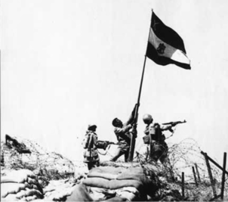
Belief perseverance
Once we believe something, we often ignore contradictory evidence

Slide 9
Primacy effect

Slide 10
Primacy effect
The first piece of information we encounter forms an impression which we later tend to “confirm”

Slide 11
Primacy effect
The first piece of information we encounter forms an impression which we later tend to “confirm”
John is: Intelligent, industrious, impulsive, critical, stubborn, envious
John is: Envious, stubborn, critical, impulsive, industrious, intelligent

Slide 12
Attitude polarization

Slide 13
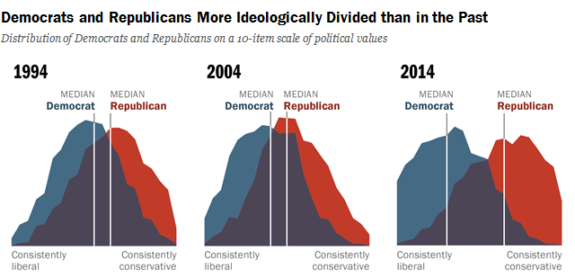
Attitude polarization
When faced with mixed evidence, people tend to become more sure of their initial position

Slide 14
A course in knowing about thinking
So far in this course:

Slide 15
A course in knowing about thinking
So far in this course:
Two systems framework
System 1 – intuitive, heuristic
System 2 – formal, logical

Slide 16
A course in knowing about thinking
So far in this course:
Two systems framework
System 1 – intuitive, heuristic
System 2 – formal, logical
Scientific method of thinking:
Correlation vs. causation
Controlled experiments
Learning from data

Slide 17
A course in knowing about thinking
So far in this course:
Two systems framework
System 1 – intuitive, heuristic
System 2 – formal, logical
Scientific method of thinking:
Correlation vs. causation
Controlled experiments
Learning from data
Heuristic thinking:
Subjective probability
Heuristics (and biases):
Availability
Representativeness
Anchoring and adjustment
Non-regressive judgment (regression to the mean)
Confirmation bias

Slide 18
Evaluating our own conclusions
How good are we at knowing when we are (likely) right?

Slide 19
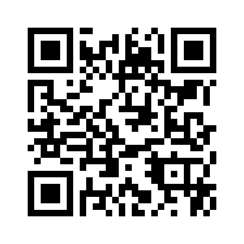
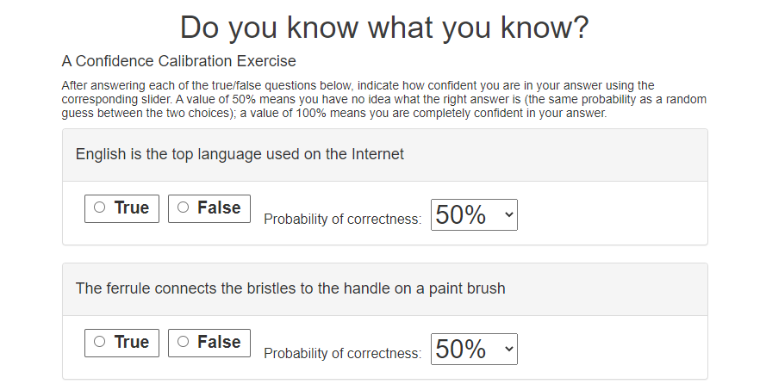
Evaluating our own conclusions
How good are we at knowing when we are (likely) right?
Lets check: http://confidence.success-equation.com/
Notes:
See also https://calibration-practice.neocities.org/

Slide 20
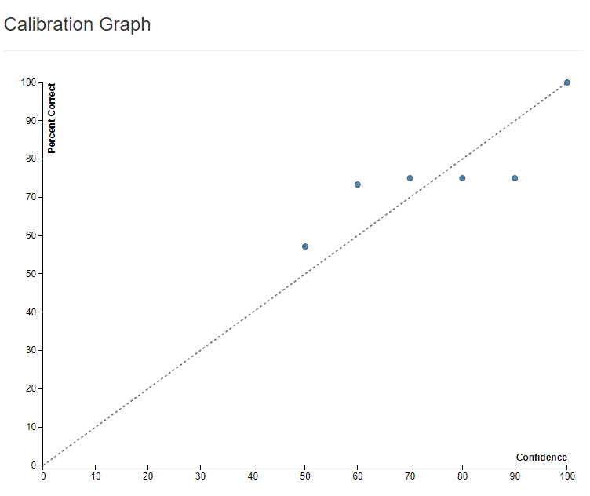
Calibration graphs
How good are we at knowing when we are (likely) right?

Slide 21
Calibration graphs
How good are we at knowing when we are (likely) right?
Proportion of correct answers
Self-assigned probability of being correct

Slide 22
Calibration graphs
How good are we at knowing when we are (likely) right?
?
Proportion of correct answers
Self-assigned probability of being correct

Slide 23
Calibration graphs
How good are we at knowing when we are (likely) right?
Perfect calibration
Proportion of correct answers
Self-assigned probability of being correct

Slide 24
Calibration graphs
How good are we at knowing when we are (likely) right?
Perfect calibration % correct = estimated % correct
Proportion of correct answers
Self-assigned probability of being correct

Slide 25
Calibration graphs
How good are we at knowing when we are (likely) right?
Perfect calibration % correct = estimated % correct
?
Proportion of correct answers
Self-assigned probability of being correct

Slide 26
Calibration graphs
How good are we at knowing when we are (likely) right?
Perfect calibration % correct = estimated % correct
Over confidence % correct < estimated % correct
Proportion of correct answers
Self-assigned probability of being correct

Slide 27
Calibration graphs
How good are we at knowing when we are (likely) right?
Perfect calibration % correct = estimated % correct
?
Over confidence % correct < estimated % correct
Proportion of correct answers
Self-assigned probability of being correct

Slide 28
Calibration graphs
How good are we at knowing when we are (likely) right?
Under confidence % correct > estimated % correct
Perfect calibration % correct = estimated % correct
Over confidence % correct < estimated % correct
Proportion of correct answers
Self-assigned probability of being correct

Slide 29
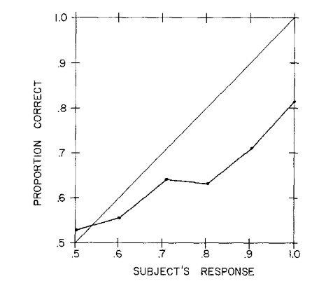
Evaluating our own conclusions
How good were you at knowing when you are (likely) right?
Experiment:
Trivia questions
Lichtenstein & Fischhoff (1977).

Slide 30
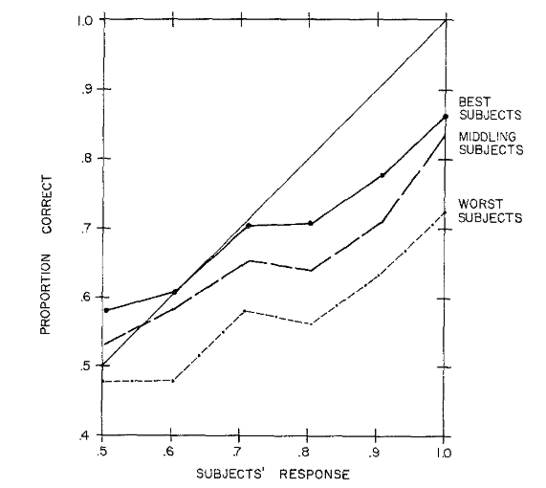
Evaluating our own conclusions
How good were you at knowing when you are (likely) right?
Experiment:
Trivia questions
Lichtenstein & Fischhoff (1977).

Slide 31
Evaluating our own conclusions
How good were you at knowing when you are (likely) right?
Experiment:
Trivia questions
Lichtenstein & Fischhoff (1977).

Slide 32
Evaluating our own conclusions
How good were you at knowing when you are (likely) right?
Experiment:
Trivia questions
Lichtenstein & Fischhoff (1977).

Slide 33
Evaluating our own conclusions
How good were you at knowing when you are (likely) right?
Experiment:
Trivia questions
Lichtenstein & Fischhoff (1977).

Slide 34
Evaluating our own conclusions
Is this just trivia?

Slide 35
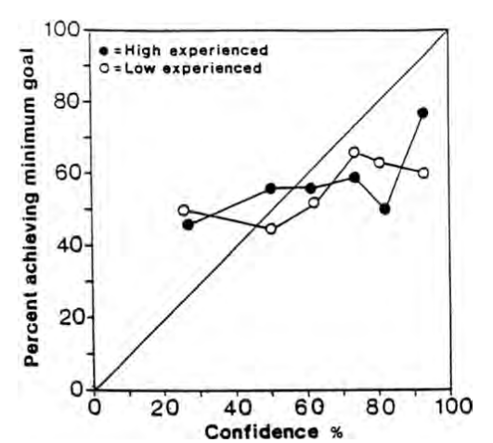
Evaluating our own conclusions
Is this just trivia?
481 US lawyers
How likely are you to achieve your goal in current case?
Goodman-Delahunty, Granhag, Hartwig & Loftus (2010).

Slide 36
Evaluating our own conclusions
Is this just trivia?
481 US lawyers
How likely are you to achieve your goal in current case?
Goodman-Delahunty, Granhag, Hartwig & Loftus (2010).

Slide 37
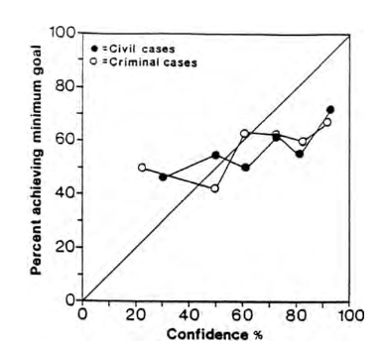
Evaluating our own conclusions
Is this just trivia?
481 US lawyers
How likely are you to achieve your goal in current case?
Goodman-Delahunty, Granhag, Hartwig & Loftus (2010).

Slide 38
Evaluating our own conclusions
Is this just trivia?
481 US lawyers
How likely are you to achieve your goal in current case?
Goodman-Delahunty, Granhag, Hartwig & Loftus (2010).

Slide 39
Evaluating our own conclusions
Is this just trivia?
481 US lawyers
How likely are you to achieve your goal in current case?
Goodman-Delahunty, Granhag, Hartwig & Loftus (2010).

Slide 40
Evaluating our own conclusions
Is this just trivia?
481 US lawyers
How likely are you to achieve your goal in current case?
Goodman-Delahunty, Granhag, Hartwig & Loftus (2010).

Slide 41
Evaluating our own conclusions
What is this effect called?
Lichtenstein & Fischhoff (1977).

Slide 42
Dunning–Kruger effect
Lichtenstein & Fischhoff (1977).

Slide 43
Dunning–Kruger effect

Slide 44
Dunning–Kruger effect
Ability to judge how skilled one is at a task depends on one’s skill level

Slide 45
Dunning–Kruger effect
Ability to judge how skilled one is at a task depends on one’s skill level
Higher skill ->

Slide 46
Dunning–Kruger effect
Ability to judge how skilled one is at a task depends on one’s skill level
Higher skill -> more accurate self assessment

Slide 47
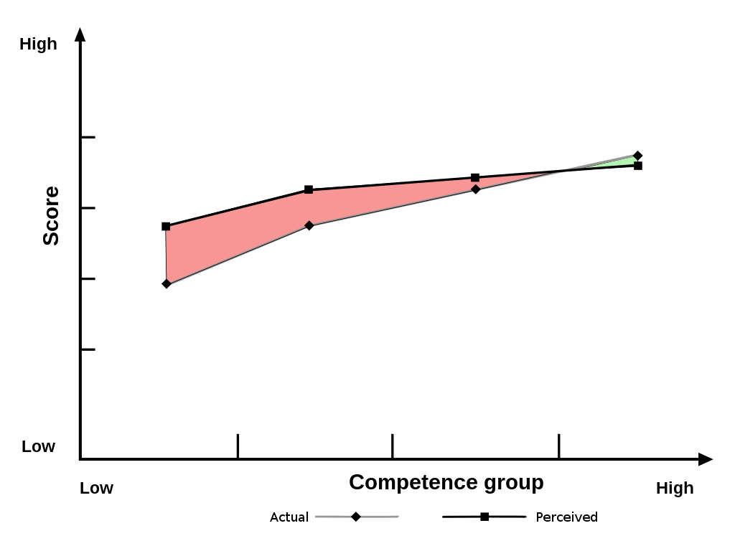

Dunning–Kruger effect
Ability to judge how skilled one is at a task depends on one’s skill level

Slide 48
Dunning–Kruger effect
Ability to judge how skilled one is at a task depends on one’s skill level
Less skilled people overestimate their ability
Highest skill people sometimes underestimate their ability

Slide 49
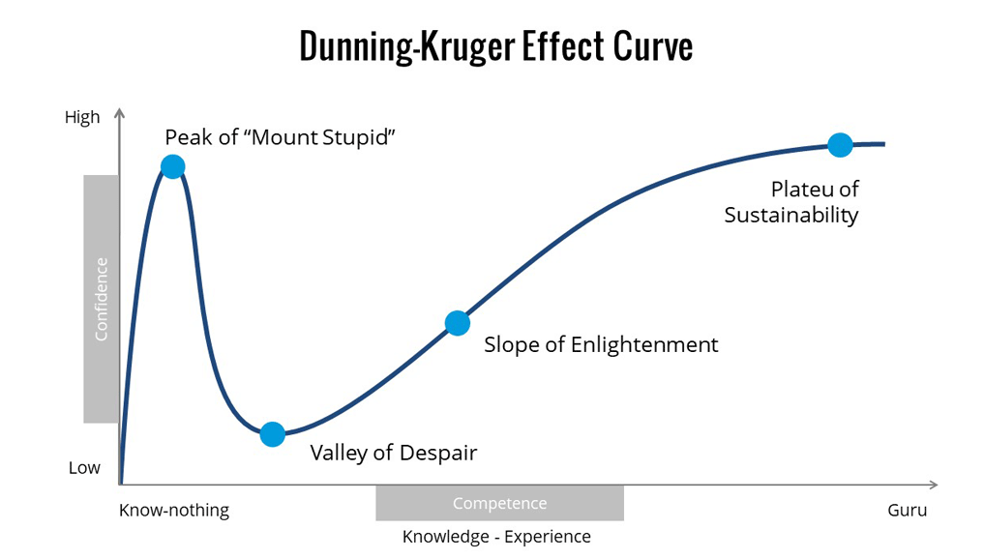
Not Dunning–Kruger effect

Slide 50
Why is it hard to know when we don’t know?

Slide 51
Why is it hard to know when we don’t know?
Illusion of explanatory depth

Slide 52
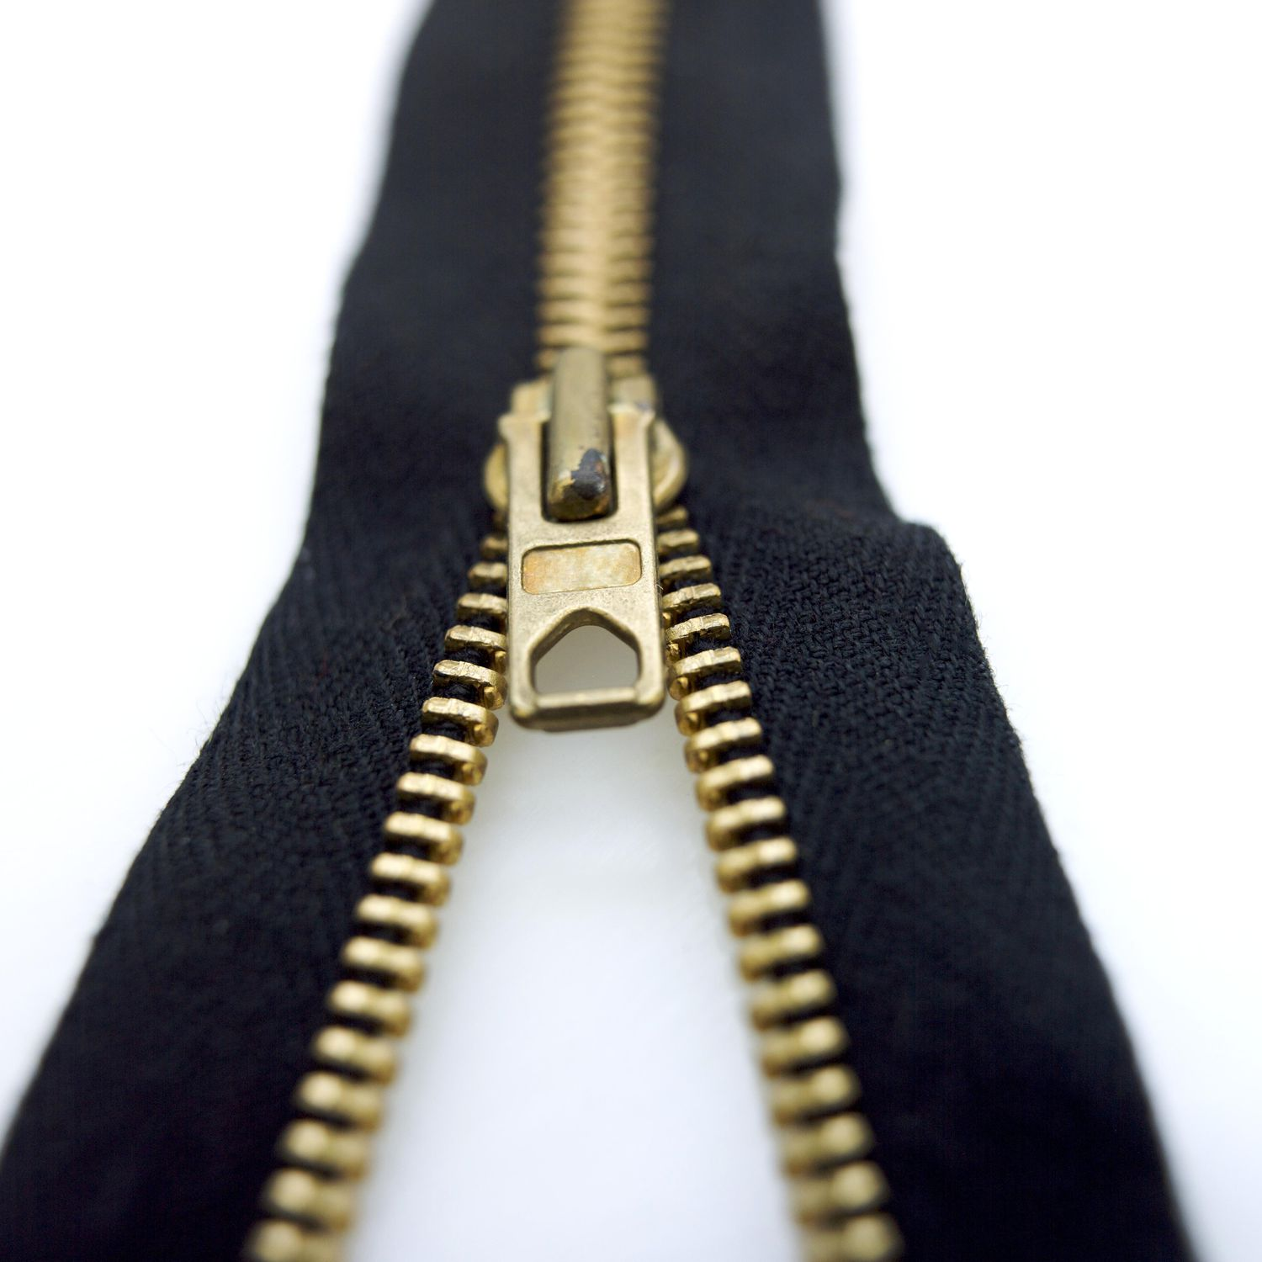
Why is it hard to know when we don’t know?
Illusion of explanatory depth
How well do you understand zippers?
1 – very little to 7 – understand fully

Slide 53
Why is it hard to know when we don’t know?
Illusion of explanatory depth
How well do you understand zippers?
1 – very little to 7 – understand fully
Try to write down an explanation of how a zipper works exactly

Slide 54
Why is it hard to know when we don’t know?
Illusion of explanatory depth
How well do you understand zippers?
1 – very little to 7 – understand fully
Try to write down an explanation of how a zipper works exactly
Rate again, how well do you understand zippers?
1 – very little to 7 – understand fully

Slide 55
Why is it hard to know when we don’t know?
A zipper track is made up of dozens of teeth, each of which combines a hook and a hollow. The idea is to latch every hook on each of the two tracks into a hollow on the opposite track. The latching mechanism, called the slide, is just a collection of wedges.
As the slide moves up the zipper, the two teeth strips must enter at a specific angle. As the strips move through the slide, the slide's inclined edges push the teeth toward each other. The strips are offset from each other, so each hollow settles onto a hook in sequence. For this to work properly, each tooth must be exactly the same size and shape, and they all must be perfectly positioned on the track. This would be all but impossible without modern manufacturing technology.
Rate again, how well did you understand zippers before?
1 – very little to 7 – understand fully

Slide 56
Why is it hard to know when we don’t know?
Illusion of explanatory depth:
People overestimate their own level of understanding of a subject if they do not put it to a test
One test: try to “unpack” (explain) your understanding

Slide 57
Why is it hard to know when we don’t know?
Another test: make predictions / estimations

Slide 58
Why is it hard to know when we don’t know?
Another test: make predictions / estimations
1. Distance from earth to nearest star (excluding sun), in light-years
90% confidence interval: [ _________ , _________ ]
Write down your answers (with question numbers)

Slide 59
Why is it hard to know when we don’t know?
Another test: make predictions / estimations
1. Distance from earth to nearest star (excluding sun), in light-years
e.g., my 90% confidence interval: [ ___2__ , ____7__ ]

Slide 60
Why is it hard to know when we don’t know?
Another test: make predictions / estimations
1. Distance from earth to nearest star (excluding sun), in light-years
e.g., my 90% confidence interval: [ ___2__ , ____7__ ]
Goal: be 90% correct (not 100%)

Slide 61
Why is it hard to know when we don’t know?
Another test: make predictions / estimations
1. Distance from earth to nearest star (excluding sun), in light-years
e.g., my 90% confidence interval: [ ___2__ , ____7__ ]
Goal: be 90% correct (not 100%) -> correct but narrow

Slide 62
Why is it hard to know when we don’t know?
Write the question number and your interval for each
2. GDP of Mongolia, in USD
90% confidence interval: [ _________ , _________ ]
3. Height of tallest man in recorded history, in inches
90% confidence interval: [ _________ , _________ ]
4. Depth of deepest part of Pacific Ocean, in meters
90% confidence interval: [ _________ , _________ ]
5. Average distance from earth to moon, in miles
90% confidence interval: [ _________ , _________ ]
6. Population of Russia in 2019
90% confidence interval: [ _________ , _________ ]

Slide 63
Why is it hard to know when we don’t know?
7. Maximum number of passengers carried on Emirates A380 aircraft (two-class layout)
90% confidence interval: [ _________ , _________ ]
8. Number of passengers who died on the Titanic
90% confidence interval: [ _________ , _________ ]
9. Market capitalization of Apple on the day Steve Jobs died, in USD
90% confidence interval: [ _________ , _________ ]
10. Fastest lap time in an F1 car around the Monaco circuit, in min:sec
90% confidence interval: [ _________ , _________ ]
11. Number of regular season goals scored by Wayne Gretzky in his NHL career
90% confidence interval: [ _________ , _________ ]

Slide 64
Why is it hard to know when we don’t know?
12. NASAs budget for the year 2019, in USD
90% confidence interval: [ _________ , _________ ]
13. Number of Big Macs sold globally in a year (on average) by McDonalds
90% confidence interval: [ _________ , _________ ]
14. Number of students from China attending U.S. colleges in the 2018-2019 academic year
90% confidence interval: [ _________ , _________ ]
15. Total number of passengers flying domestically on U.S. airlines in 2019
90% confidence interval: [ _________ , _________ ]
16. Amount of coal produced by U.S. mines in 2019, in pounds
90% confidence interval: [ _________ , _________ ]

Slide 65
Why is it hard to know when we don’t know?
17. Breeds eligible to compete at the 144th Westminster Kennel Dog Show
90% confidence interval: [ _________ , _________ ]
18. Number of total worldwide searches processed by Google each day
90% confidence interval: [ _________ , _________ ]
19. Full weight (including planes, ammunition, people) of a Nimitz-class aircraft carrier, in pounds
90% confidence interval: [ _________ , _________ ]
20. Number of times that the name “Jesus” appears in the King James bible
90% confidence interval: [ _________ , _________ ]

Slide 66
Why is it hard to know when we don’t know?
Answers:
A1: 4.2441
A2: $13,637,000,000
A3: 107 inches
A4: 10,984 meters
A5: 237,674.5 miles away
A6: 145,872,256 people
A7: 615 seats
A8: 1,517 people
A9: $351.5 billion
A10: 1:14.260 min:sec
A11: 894 goals
A12: $19,653,000,000
A13: 550,000,000 Big Macs
A14: 369,548 students
A15: 811,400,000 passengers
A16: 1,410,518,000,000 pounds
A17: 205 breeds and varieties
A18: 3,500,000,000 searches per day
A19: 226,679,700 pounds
A20: 942 times

Slide 67
Why is it hard to know when we don’t know?
Answers:
A1: 4.2441
A2: $13,637,000,000
A3: 107 inches
A4: 10,984 meters
A5: 237,674.5 miles away
A6: 145,872,256 people
A7: 615 seats
A8: 1,517 people
A9: $351.5 billion
A10: 1:14.260 min:sec
A11: 894 goals
A12: $19,653,000,000
A13: 550,000,000 Big Macs
A14: 369,548 students
A15: 811,400,000 passengers
A16: 1,410,518,000,000 pounds
A17: 205 breeds and varieties
A18: 3,500,000,000 searches per day
A19: 226,679,700 pounds
A20: 942 times
Count how many were within your confidence interval

Slide 68
Why is it hard to know when we don’t know?
Answers:
A1: 4.2441
A2: $13,637,000,000
A3: 107 inches
A4: 10,984 meters
A5: 237,674.5 miles away
A6: 145,872,256 people
A7: 615 seats
A8: 1,517 people
A9: $351.5 billion
A10: 1:14.260 min:sec
A11: 894 goals
A12: $19,653,000,000
A13: 550,000,000 Big Macs
A14: 369,548 students
A15: 811,400,000 passengers
A16: 1,410,518,000,000 pounds
A17: 205 breeds and varieties
A18: 3,500,000,000 searches per day
A19: 226,679,700 pounds
A20: 942 times
Count how many were within your confidence interval:
Less than 18 -> overconfident
18 -> accurate
More than 18 -> underconfident

Slide 69
Why is it hard to know when we don’t know?
We do not often test ourselves on how accurately we estimate our own knowledge

Slide 70
Learn to know what you know
We do not often test ourselves on how accurately we estimate our own knowledge
Training exercise: make predictions / estimations in you own life:

Slide 71
Learn to know what you know
We do not often test ourselves on how accurately we estimate our own knowledge
Training exercise: make predictions / estimations in you own life:
Test scores for this semester
Numerical job performance indicators (e.g., number of sales in a month)
Time to complete common tasks (e.g., get ready to go out, make dinner)

Slide 72
Learn to know what you know
We do not often test ourselves on how accurately we estimate our own knowledge
Training exercise: make predictions / estimations in you own life:
Test scores for this semester
Numerical job performance indicators (e.g., number of sales in a month)
Time to complete common tasks (e.g., get ready to go out, make dinner)
Make your predictions as confidence intervals, keep (written) track, adjust accordingly

Slide 73
Is it good to be accurate?

Slide 74
Is it good to be accurate?
Optimism bias: Most people, in most contexts, underestimate their risk exposure (how likely they are to experience negative outcomes) and overestimate their likelihood of success (how likely they are to experience good outcomes)

Slide 75
Is it good to be accurate?
Optimism bias: Most people, in most contexts, underestimate their risk exposure (how likely they are to experience negative outcomes) and overestimate their likelihood of success (how likely they are to experience good outcomes)
E.g.,

Slide 76
Is it good to be accurate?
Optimism bias: Most people, in most contexts, underestimate their risk exposure (how likely they are to experience negative outcomes) and overestimate their likelihood of success (how likely they are to experience good outcomes)
Depressed people:

Slide 77
Is it good to be accurate?
Optimism bias: Most people, in most contexts, underestimate their risk exposure (how likely they are to experience negative outcomes) and overestimate their likelihood of success (how likely they are to experience good outcomes)
Depressed people: accurate or pessimistically biased

Slide 78
Is it good to be accurate?
Planning fallacy:

Slide 79
Is it good to be accurate?
Planning fallacy: people very often underestimate the time (and cost) needed to complete a future task or project

Slide 80
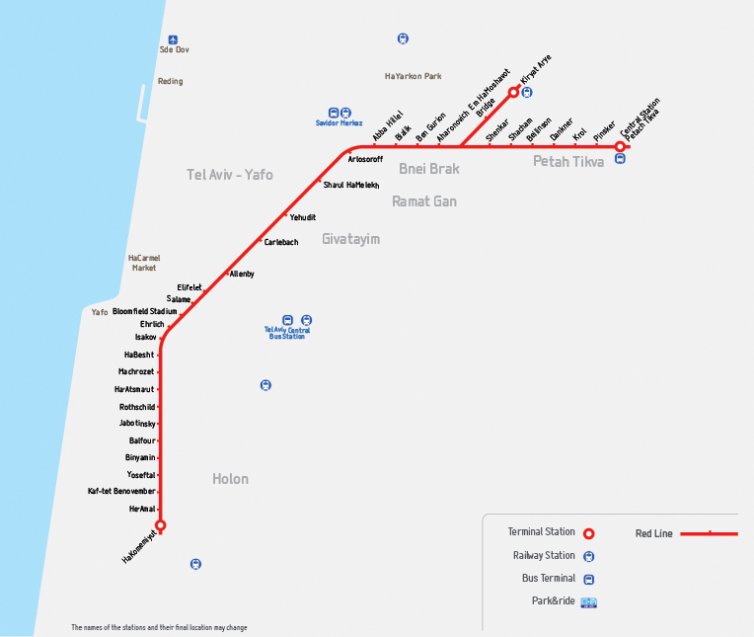
Is it good to be accurate?
Planning fallacy: people very often underestimate the time (and cost) needed to complete a future task or project
Oct. 2021
Nov. 2022
March 2023
May 2023
18.8.2023

Slide 81
Is it good to be accurate?
Planning fallacy: people very often underestimate the time (and cost) needed to complete a future task or project
Think of your last class assignment:
When did you predict you will submit your assignment?
When did you actually submit?

Slide 82
Is it good to be accurate?
Planning fallacy: people very often underestimate the time (and cost) needed to complete a future task or project
Experiment: students predict how long a seminar paper will take them

Slide 83
Is it good to be accurate?
Planning fallacy: people very often underestimate the time (and cost) needed to complete a future task or project
Experiment: students predict how long a seminar paper will take them
Average estimate: 33.9 days.

Slide 84
Is it good to be accurate?
Planning fallacy: people very often underestimate the time (and cost) needed to complete a future task or project
Experiment: students predict how long a seminar paper will take them
Average estimate: 33.9 days.
Average estimate "if everything went as well as it possibly could“: 27.4 days
Average estimate "if everything went as poorly as it possibly could" 48.6 days

Slide 85
Is it good to be accurate?
Planning fallacy: people very often underestimate the time (and cost) needed to complete a future task or project
Experiment: students predict how long a seminar paper will take them
Average estimate: 33.9 days.
Average estimate "if everything went as well as it possibly could“: 27.4 days
Average estimate "if everything went as poorly as it possibly could" 48.6 days
Actual average completion time: 55.5 days

Slide 86
Is it good to be accurate?
Planning fallacy: people very often underestimate the time (and cost) needed to complete a future task or project
Arguably a specific case of optimism bias

Slide 87
Is it good to be accurate?
Planning fallacy: people very often underestimate the time (and cost) needed to complete a future task or project
The planning fallacy can easily lead to failures (overdue assignment, project failing due to insufficient budget)

Slide 88
Is it good to be accurate?
Planning fallacy: people very often underestimate the time (and cost) needed to complete a future task or project
But, it can also be useful

Slide 89
Is it good to be accurate?
Planning fallacy: people very often underestimate the time (and cost) needed to complete a future task or project
But, it can also be useful
Externally: easier getting funding / approval for optimistic predictions

Slide 90
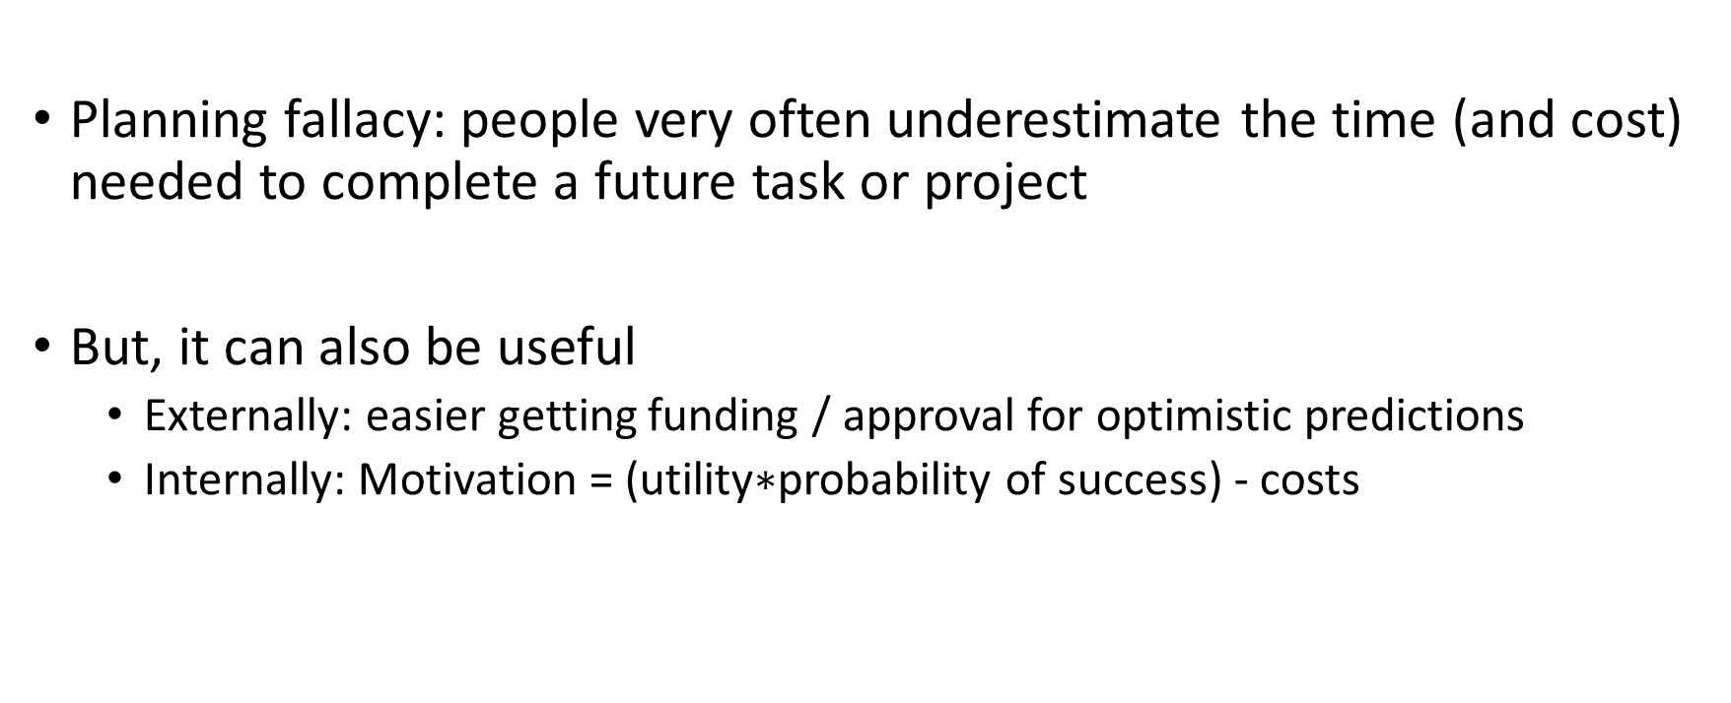
Is it good to be accurate?
Planning fallacy: people very often underestimate the time (and cost) needed to complete a future task or project
But, it can also be useful
Externally: easier getting funding / approval for optimistic predictions
Internally: Motivation = (utility$∗$probability of success) - costs

Slide 91
Is it good to be accurate?
Planning fallacy: people very often underestimate the time (and cost) needed to complete a future task or project
Counteracting the planning fallacy:

Slide 92
Is it good to be accurate?
Planning fallacy: people very often underestimate the time (and cost) needed to complete a future task or project
Counteracting the planning fallacy:
Task segmentation

Slide 93
Is it good to be accurate?
Planning fallacy: people very often underestimate the time (and cost) needed to complete a future task or project
Counteracting the planning fallacy:
Task segmentation
Estimation based on past results of similar cases

Slide 94
Summary
Calibration:
People tend to be uncalibrated in estimating the probability of their own predictions (usually overconfident)
Dunning-Kruger effect: the less skilled someone is at a task, the more they overestimate their skill level
To improve your calibration, test yourself
Planning fallacy: we consistently underestimate the cost (time / money / effort) of our own planned projects

Slide 95
Thursday at 17:30
Questions about subjects we covered during the course
Question about the final assignment

Slide 96
“When you are dead, you do not know you are dead. It is only painful for others. The same applies when you are stupid.”
― Ricky Gervais

